Slide 1
FELRA EGWP 2021
STRATEGIC PLANNING
AND REVIEW CONSULTATION
Notes:
SLIDE TAGS AVAILABLE

Slide 2
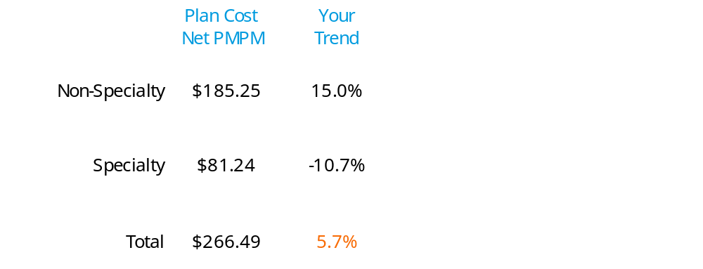
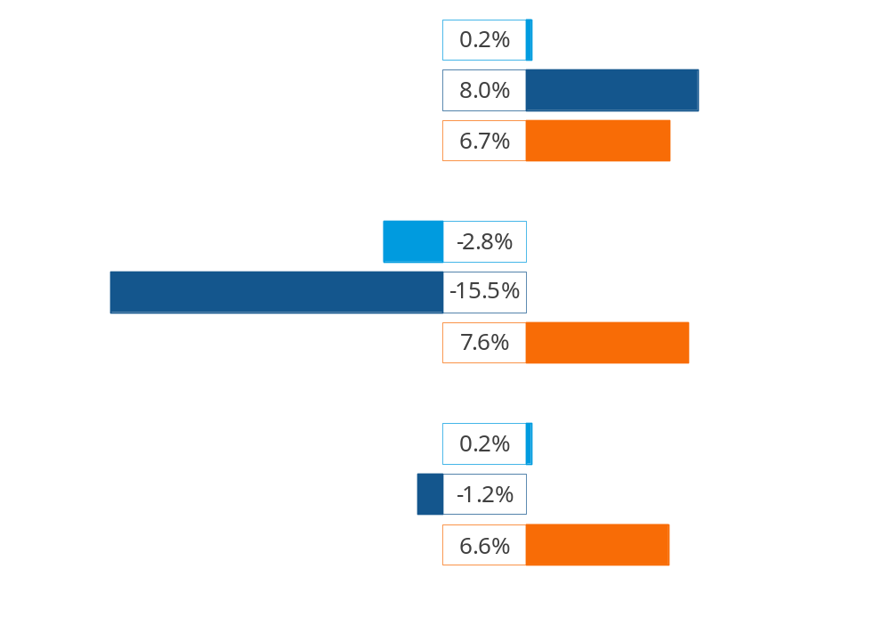
Trend Components Plan Cost Net PMPM
Utilization
Unit Cost
Cost Share
Notes:
2

Slide 3
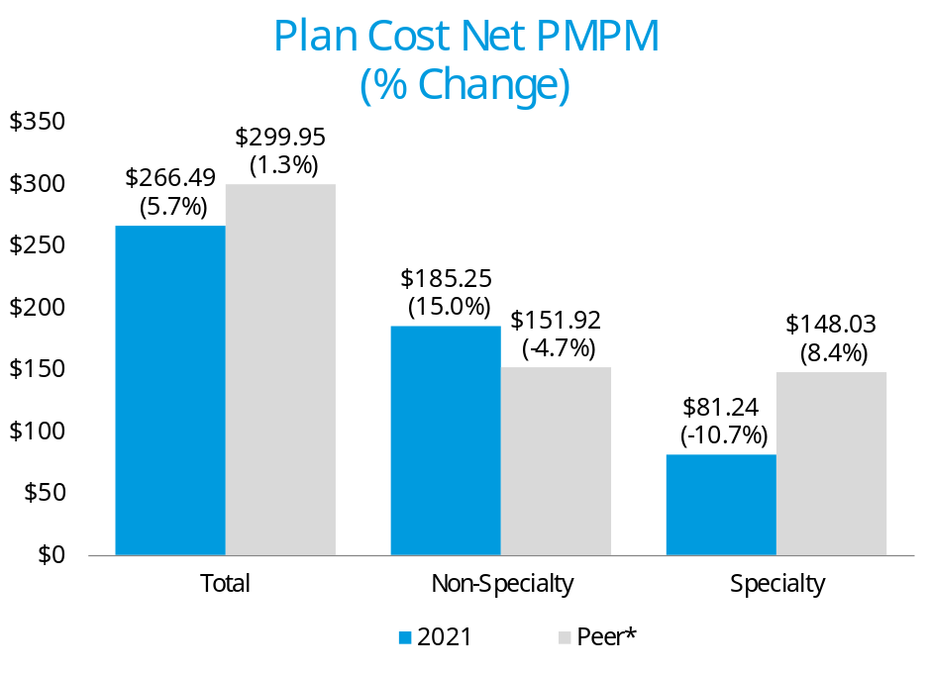
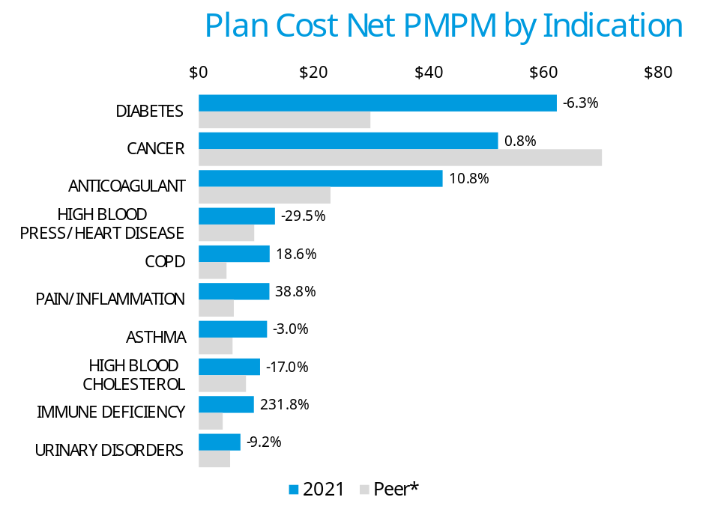
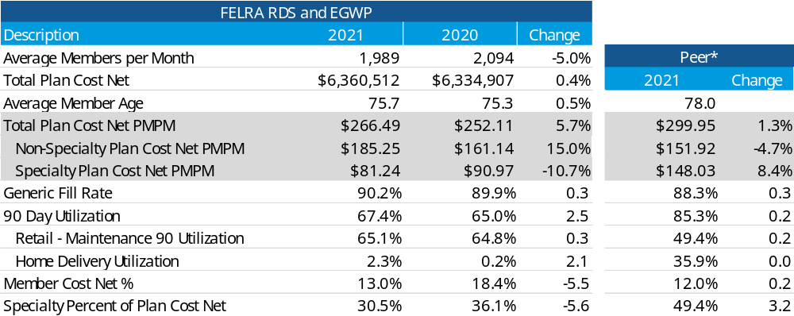
Trend Dashboard – How Your Plan Compares
COVID-19 Vaccine Impact
*Peer = 'Commercial - EGWP' market segment

Slide 4
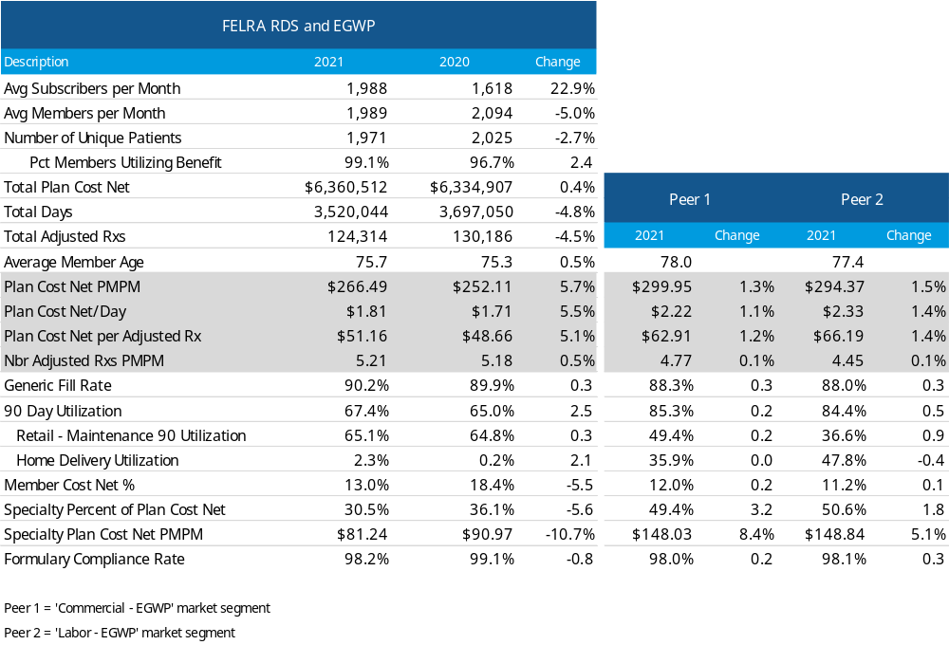
Top Line Performance Metrics
Notes:
Talking Points:
- Compare metrics for your plan, year over year, and highlight any significant changes (improvements or concerning declines)
- Compare a few metrics to the Peer group and highlight areas where the client is performing well or areas of concern where the client may want to consider management strategies
+Typically the most important metrics to compare are: Plan Cost PMPM, Plan Cost PMPM % Change, GFR, HD Utilization, Member Cost Share, and Specialty % of Plan Cost
- Highlight membership changes if applicable, since this may affect trends (different members using different meds):
+ Growth or decrease in avg members per month
+ Did the population experience an increase/decrease in younger, lower utilizing members or older, higher utilizers? An influx of healthier members will typically bring down utilization (avg days of therapy per member) and PMPM costs, and an influx of less healthy members will have the opposite impact.
+ Populations with high turnover (such as Medicaid or COBRA) may show a significant change in PMPM with minimal change in total membership
+ Companies with high turnover (i.e. service industry and retail) can have member churn of 50%
- Age of population is one of the most important factors affecting utilization. Make sure to compare to a Peer group with an applicable demographic (i.e. compare to Over or Under Age 65 benchmarks).
- Plan Cost PMPM = Plan Cost / average members / # of months
+ Plan Cost PMPM will vary based on factors such as GFR, HD Utilization, Avg Age, Specialty use, Member Cost Share and health status (% of membership that is Chronic & Complex)
+ Rebates not included
- Trend = Percent change in Plan Cost PMPM
+ Typically with a stable population and no major plan changes, trend is expected to increase in the single digits. Manufacturer price increases, higher disease prevalence and higher Specialty use are major drivers of positive trend.
+ Negative trend can be driven by changes in membership (increase in healthier, lower utilizers), patent expirations, copay/plan design changes, improved pricing, home delivery programs and other clinical programs such as PA/step therapy
- Generic Fill Rate (GFR) = Number of Generic Rxs/ Number of Total Rxs
+ Factors that typically lead to GFR increasing year over year: patent expirations, increase in HD utilization (Generic Substitution Rates higher at HD vs. Retail), plan design (such as copay differentials between brands and generics), Mandatory/Preferred Generics, online tools such as My Rx Choices, step therapy and PA programs and formulary changes
- Home Delivery Utilization = # of Home Delivery Days of Therapy / # of Total Days of Therapy
+ HD utilization shows the % of the total volume of therapy that is dispensed through the Home Delivery channel
+ A significant change in HD Utilization will affect overall cost per Rx and Utilization (Nbr Rxs PMPM) in the same direction (i.e., a high increase in HD will result in a high increase in cost per Rx trend due to 90 day supplies being dispensed vs. only 30 days) unless scripts are converted to 30 day equivalents
+ An increase in HD Utilization typically saves money on a Gross Cost basis, and as long as the copays are aligned between Retail and Mail the plan will also save (Copay Alignment)
- Member Cost Share = member out of pocket costs / Gross Cost
+ Represents the % of the cost of drugs that members pay
+ Includes impact of copays, coinsurance, deductibles, mandatory HD penalties, mandatory generic penalties, out of pocket maximums, benefit caps, etc.
+ Cost share will typically erode year over year if flat copays or MOOP remain unchanged due to manufacturer price increases
- Specialty % of Plan Cost = % of total plan cost that Specialty drugs account for
+ The Specialty pipeline is robust so Specialty utilization is expected to continue growing in the future
+ An increase of just a few Specialty patients of high cost can cause Specialty trends to increase significantly (especially if they happen to be on very costly Specialty meds with costs >$200k per year)
+ An increase may also occur if there was movement of Specialty drugs out of the medical benefit and into the pharmacy benefit (Medical Channel Management). This often may be net savings for clients when comparing pharmacy specialty costs to medical specialty costs, but will only show up as a cost increase on this report.

Slide 5
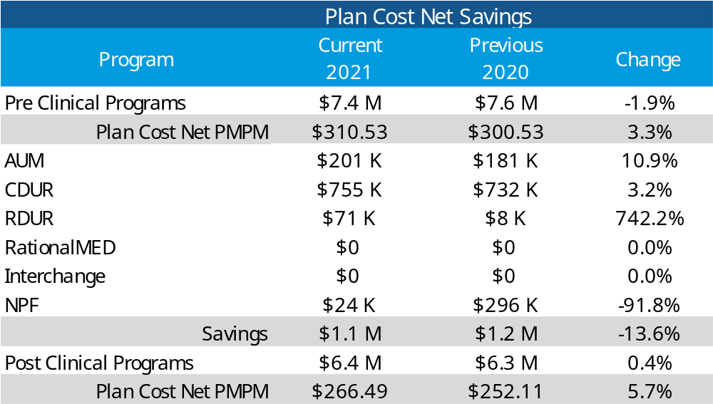
Clinical Savings and Impact
AUM - Advanced Utilization Management
CDUR - Concurrent Drug Utilization Review (health and safety edits)
RDUR - Retrospective Drug Utilization Review
RationalMED - Clinical Outreach Program that includes messaging to physicians, pharmacists, and members (optional) regarding health and safety issues.
Interchange - Consists of two primary programs
The first targets Multi-Source Brand drugs with DAW 1 or 2 alerting patients or prescribers of a Generic equivalent.
The second program targets non-preferred Single-Source Brand drugs alerting prescribers of a therapeutically equivalent lower cost Generic alternative or Preferred Brand.
NPF - National Preferred Formulary
Program fees are not included in these savings numbers
Notes:
Utilization Management program offerings are the #1 tool for decreasing client spend on their pharmacy benefit. Program offerings are the first step in managing existing and future member utilization. These offerings include Prior Authorization (PA), Drug Quantity Management (DQM), Step Therapy (ST) and Preferred Specialty Management (PSM).

Slide 6
Specialty Plan Cost Net PMPM
By Indication
Notes:
2

Slide 7
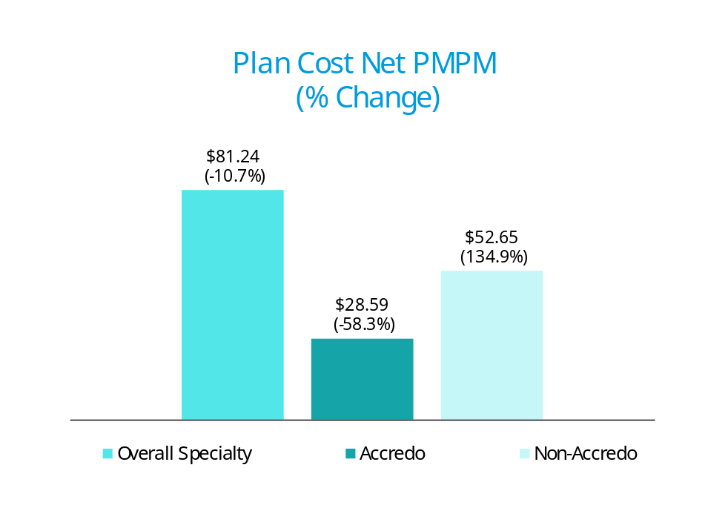
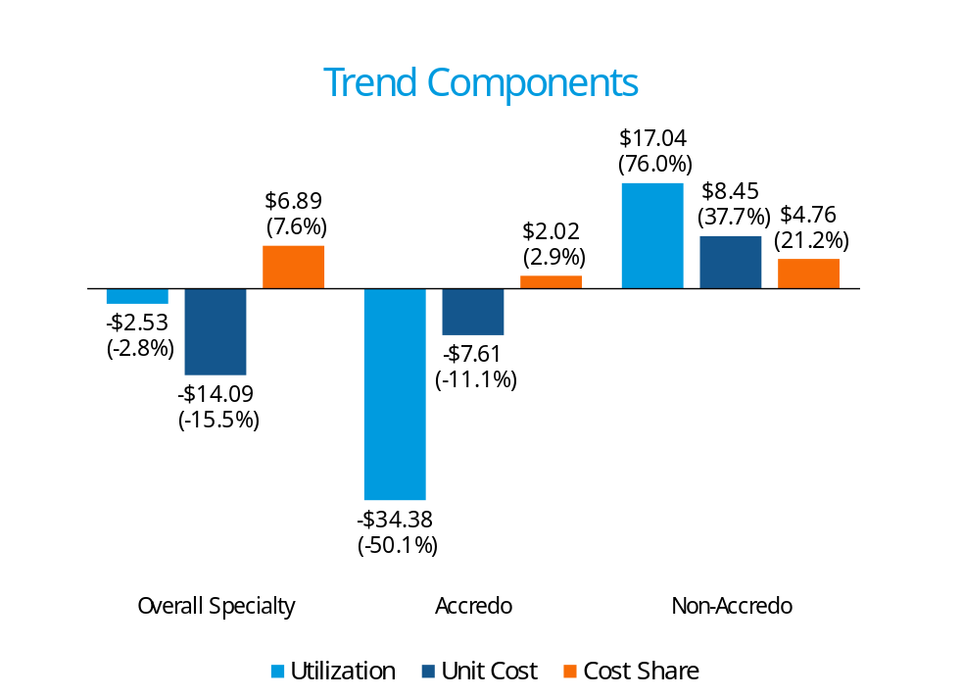
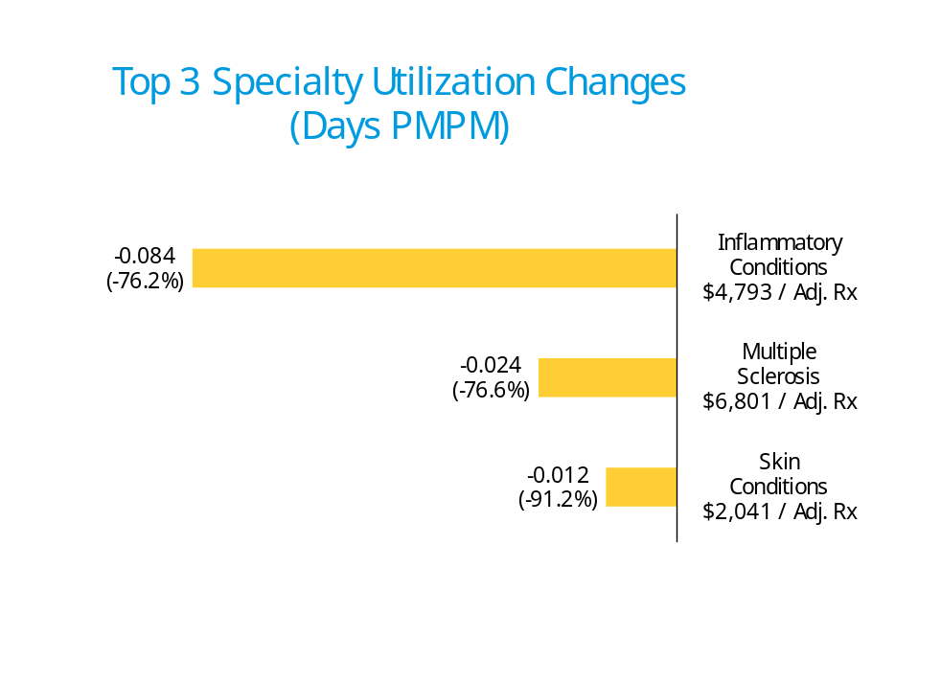
Specialty Trend Breakout
Notes:
2

Slide 8
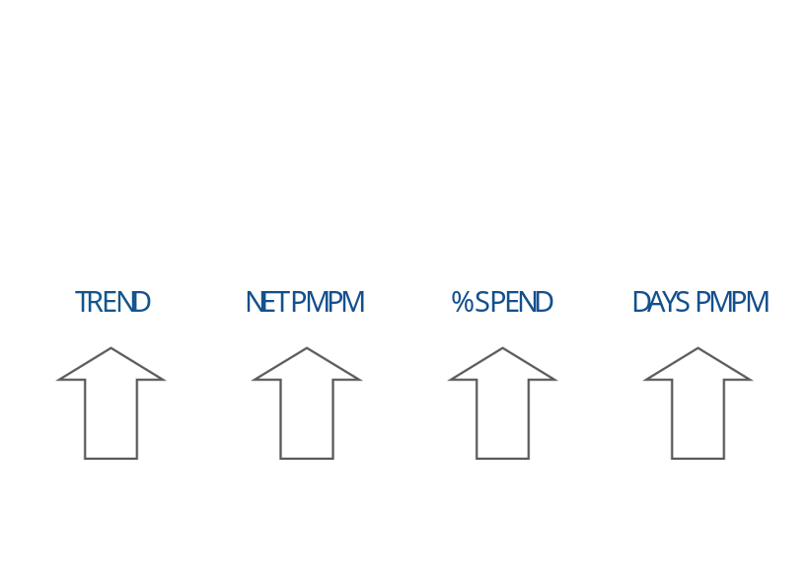
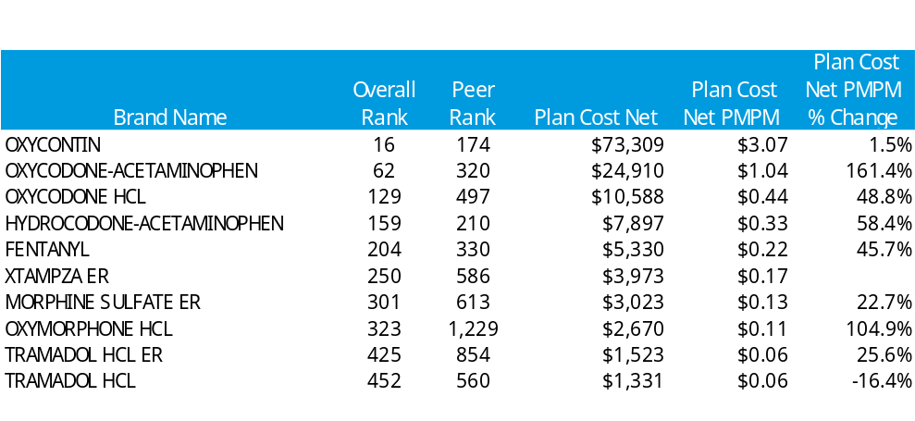
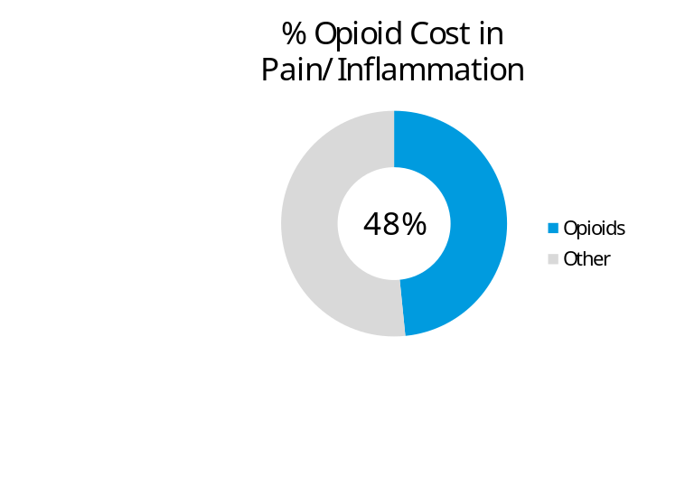
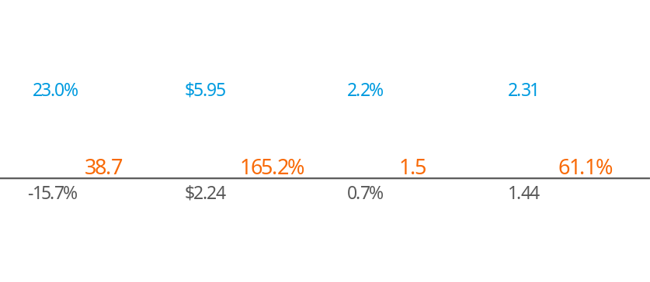
OPIOIDS
Indications driving trend
Overarching concerns over opioid abuse across the healthcare landscape will contribute to influence negative utilization trends throughout the next 3 years
You vs. Peer
Peer = 'Commercial - EGWP' market segment

Slide 9
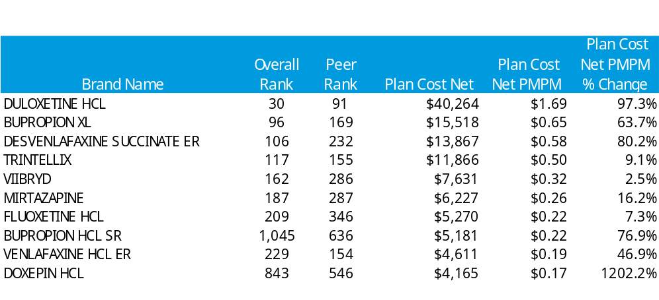
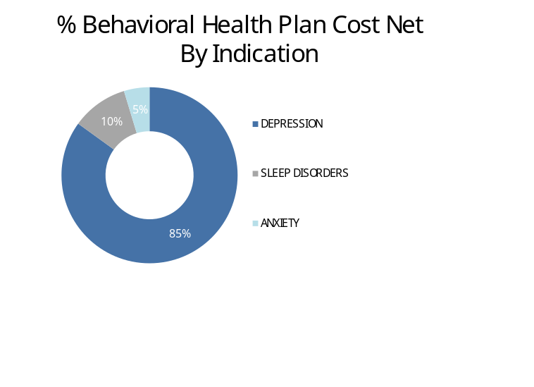
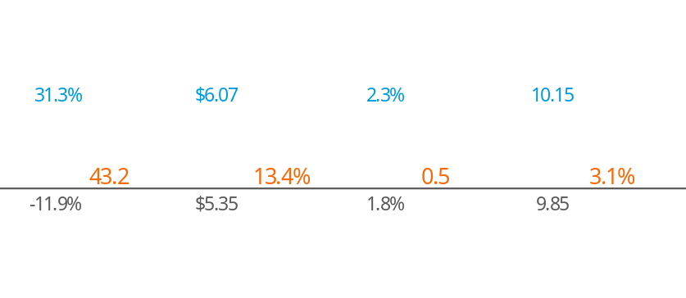
BEHAVIORAL HEALTH
Indications driving trend
Depression and anxiety disorders cost the global economy $1 trillion each year in lost productivity.¹
You vs. Peer
Peer = 'Commercial - EGWP' market segment
1. National Alliance of Mental Illness

Slide 10
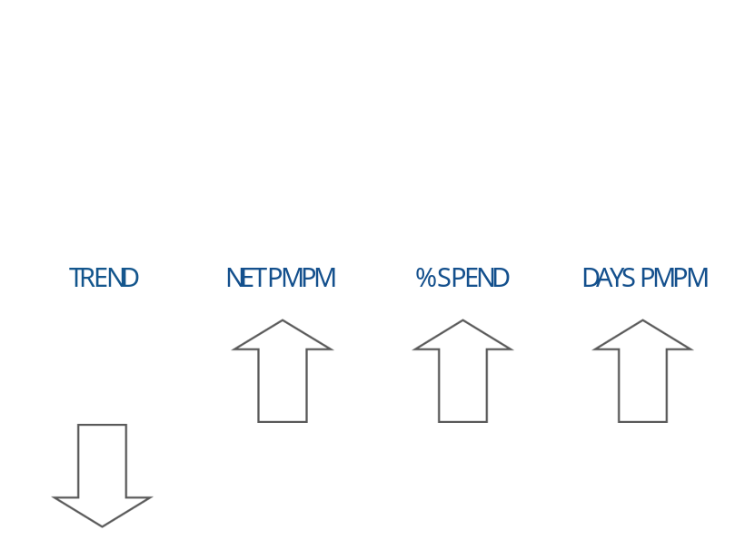
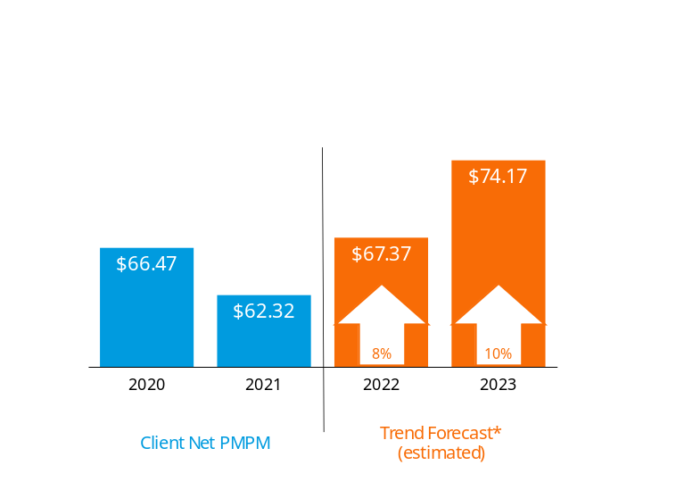
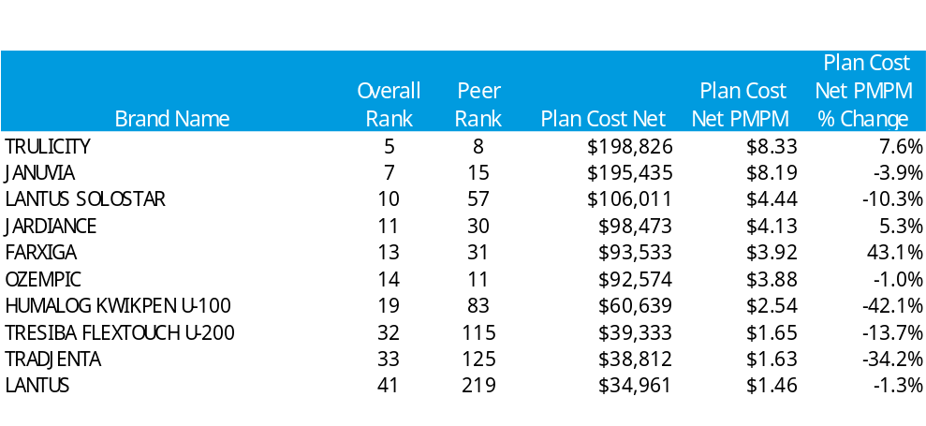
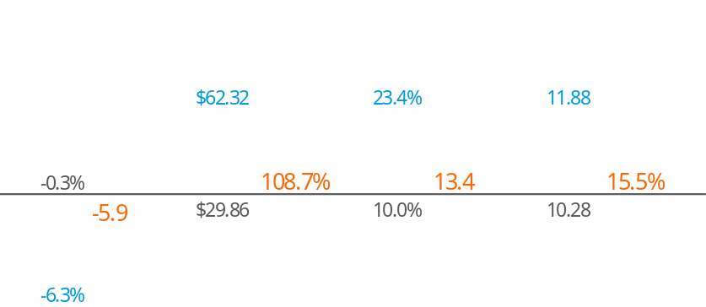
DIABETES
Indications driving trend
Diabetes trend should fluctuate between 8% - 11% through 2023. The trend will be influenced by both increases in utilization and cost.
You vs. Peer
Peer = 'Commercial - EGWP' market segment
*Based on 2020 Drug Trend Report forecasted values for Commercial Plans

Slide 11
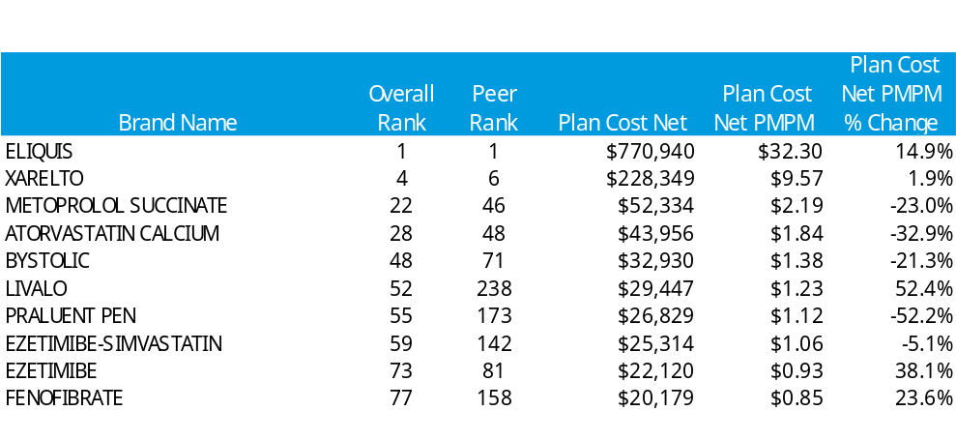
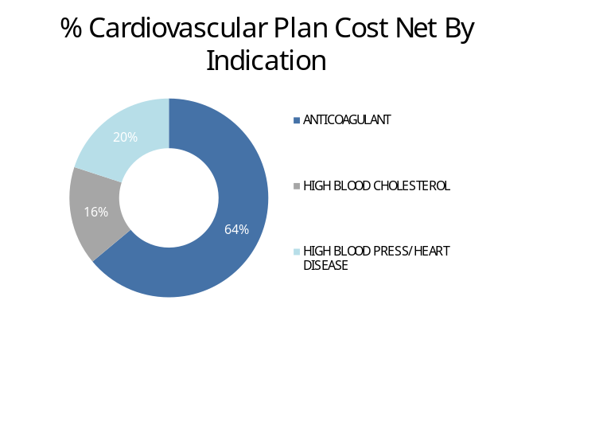
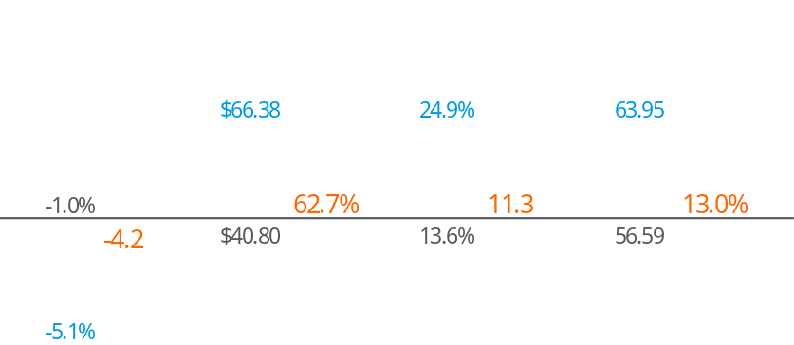
CARDIOVASCULAR
Indications driving trend
Cardiovascular related diseases cost our health care system approximately $214B per year and cause $138B in lost productivity on the job.¹
You vs. Peer
Peer = 'Commercial - EGWP' market segment
1. Centers for Disease Control and Prevention

Slide 12
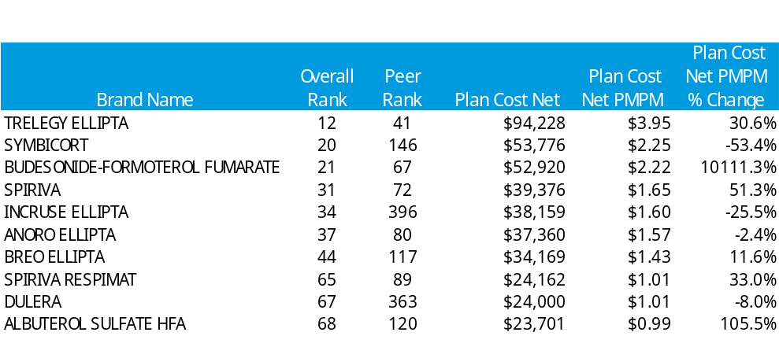
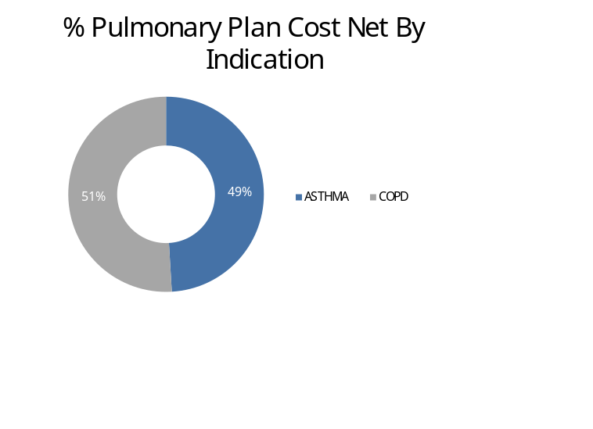
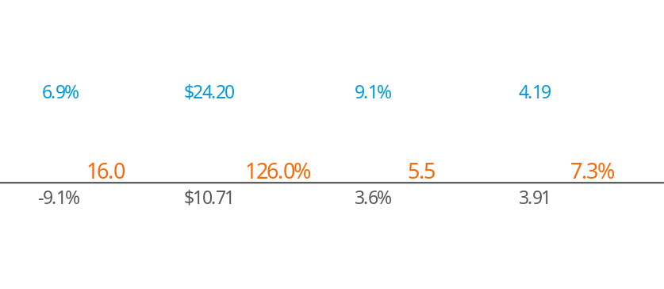
PULMONARY
Indications driving trend
The estimated cost of respiratory disease nonadherence is $35,000 a year per patient.¹
You vs. Peer
Peer = 'Commercial - EGWP' market segment
1. World Allergy Organization, Asthma Medication Adherence

Slide 13
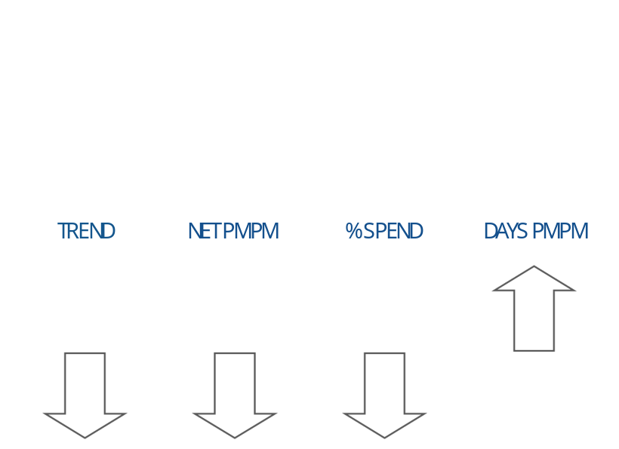
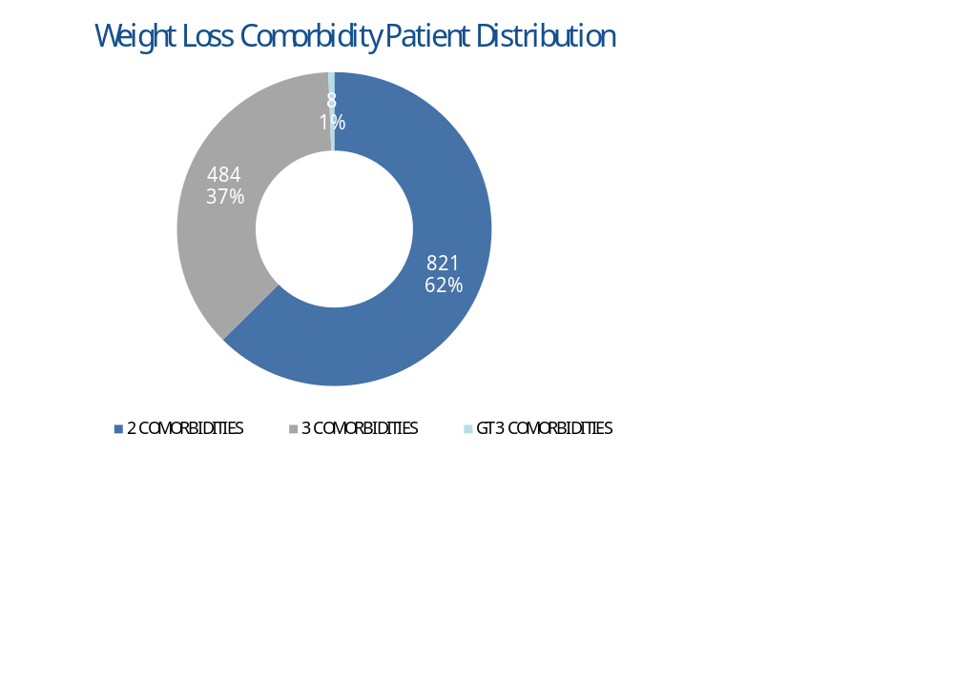
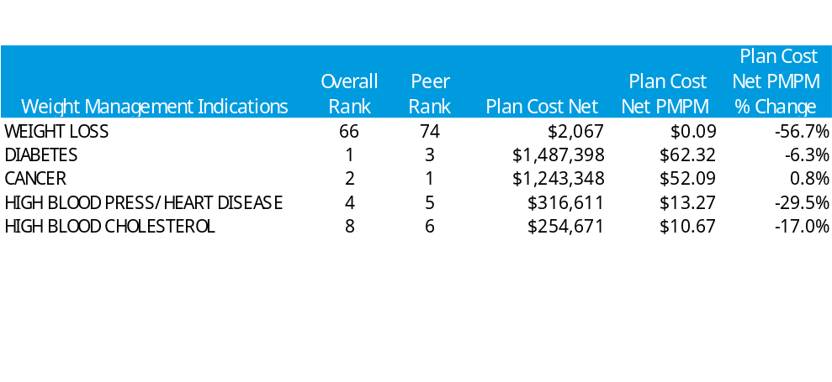
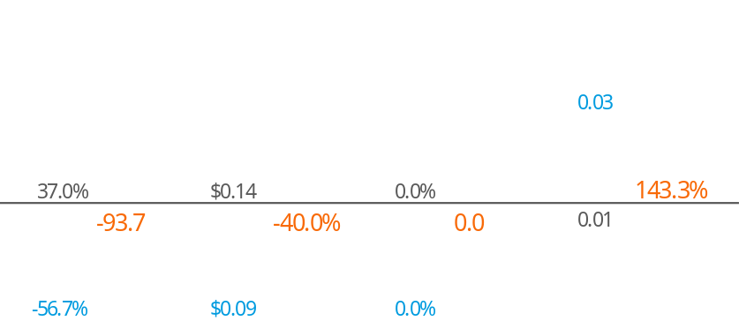
WEIGHT MANAGEMENT
Indications driving trend
America's Obesity Crisis assesses the role excess weight plays in the prevalence of 23 chronic diseases and the economic consequences that result. Obesity and overweight are linked to:
75% of osteoarthritis cases | 64% of Type 2 diabetes cases | 73% of kidney disease cases
You vs. Peer
*Weight Loss only
Peer = 'Commercial - EGWP' market segment
Notes:
America's Obesity Crisis assesses the role excess weight plays in the prevalence of 23 chronic diseases and the economic consequences that result. To mention a few, obesity and overweight are linked to:
75 percent of osteoarthritis cases
64 percent of Type 2 diabetes cases
73 percent of kidney disease cases
https://www.sciencedaily.com/releases/2018/10/181030163458.htm

Slide 14
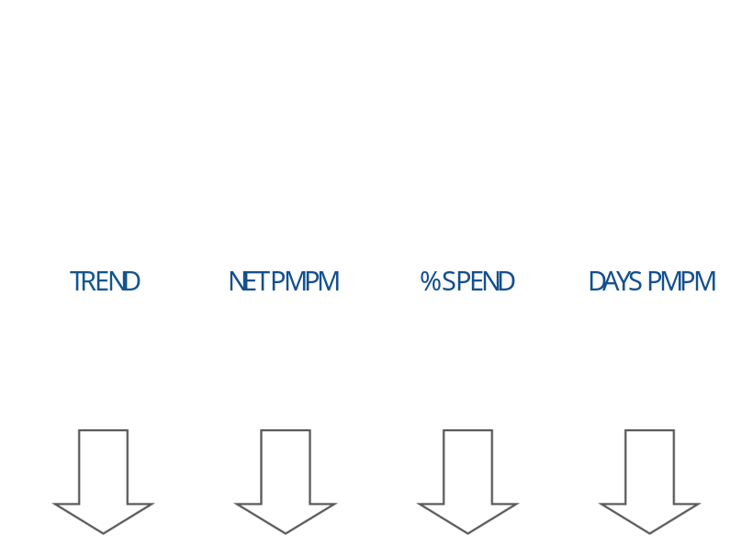
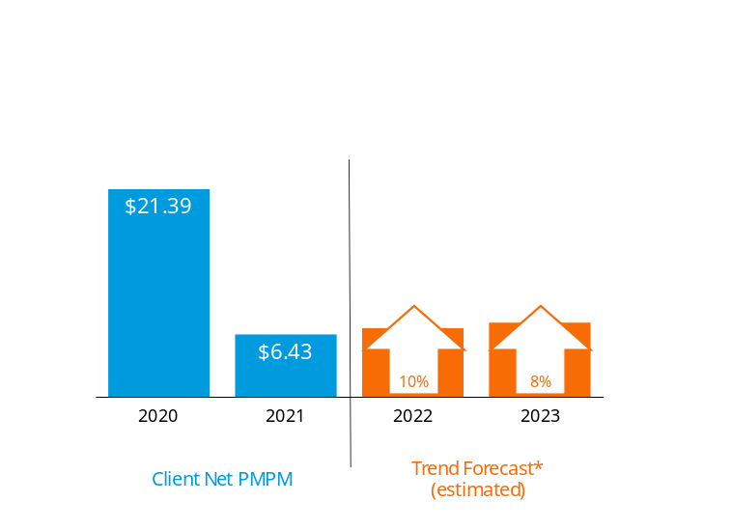
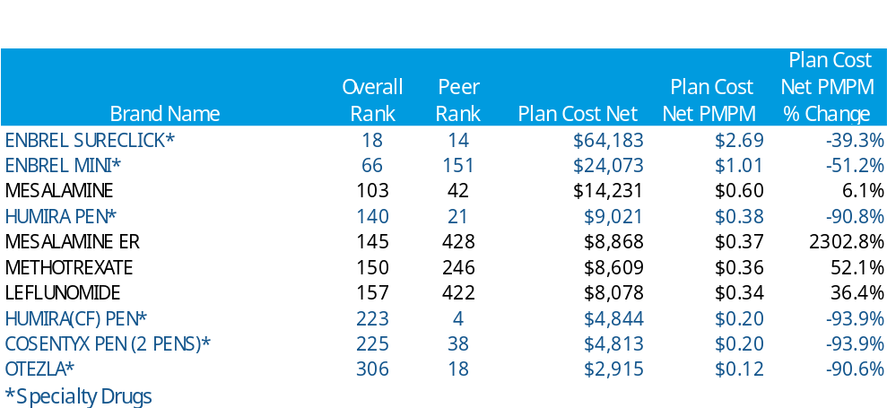
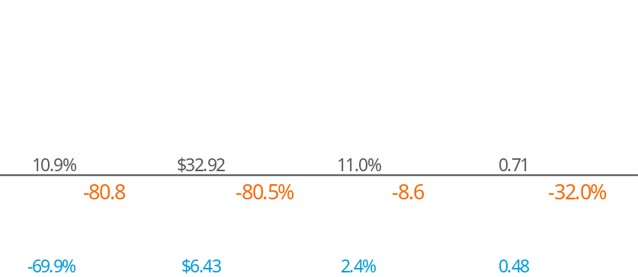
INFLAMMATORY CONDITIONS
Indications driving trend
Trends will continue over the next couple years, influenced by brand price increases and to a lesser extent increases in utilization. In 2021-2022 new formulations of existing medications to treat ulcerative colitis may result in patients shifting therapies within this class.
You vs. Peer
Peer = 'Commercial - EGWP' market segment
*Based on 2020 Drug Trend Report forecasted values for Commercial Plans

Slide 15
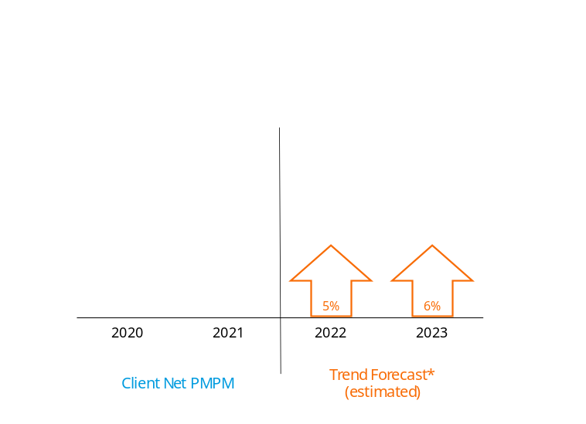
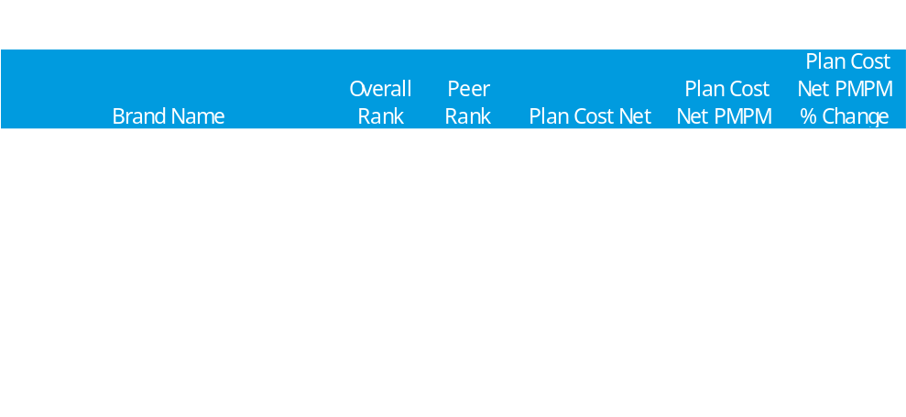
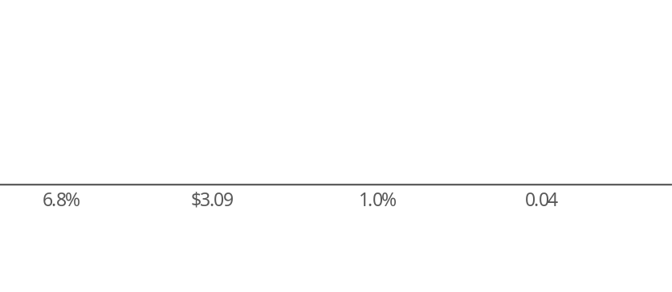
HIV
Indications driving trend
HIV trend will remain around 5% through 2023 primarily due to increases in utilization. In 2020, the generic for Truvada® (emtricitabine-tenofovir) was released yet Descovy® (emtricitabine/tenofovir) is still gaining traction amongst PrEP patients due to reduced side effects.
You vs. Peer
Peer = 'Commercial - EGWP' market segment
*Based on 2020 Drug Trend Report forecasted values for Commercial Plans

Slide 16
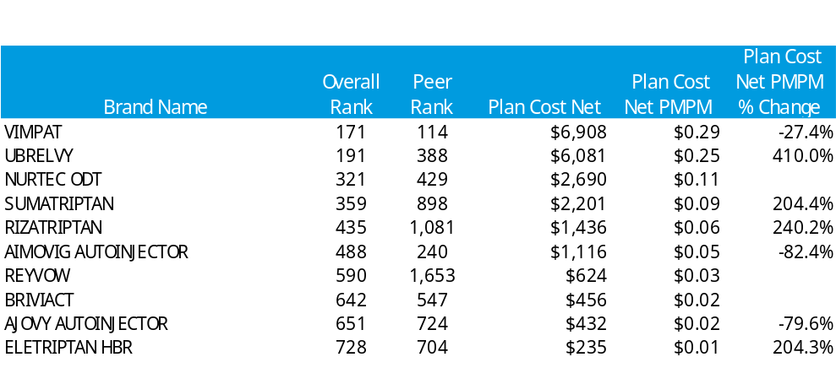
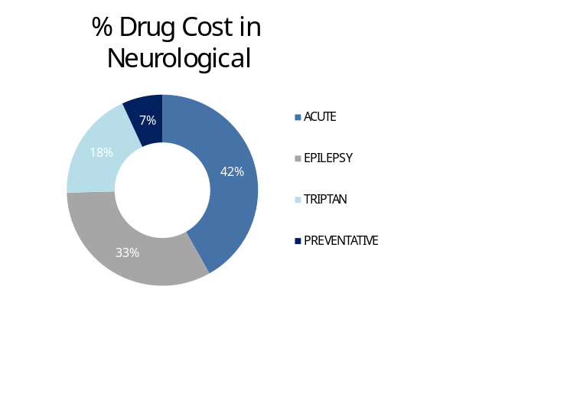
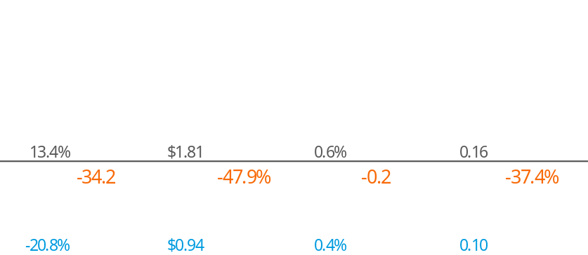
NEUROLOGICAL
Indications driving trend
While CGRP inhibitors have been proven to reduce the number of migraines a sufferer has each month, they can cost a plan more per patient per year. However, these new therapies can provide relief not seen before with other treatments.
You vs. Peer
Peer = 'Commercial - EGWP' market segment

Slide 17
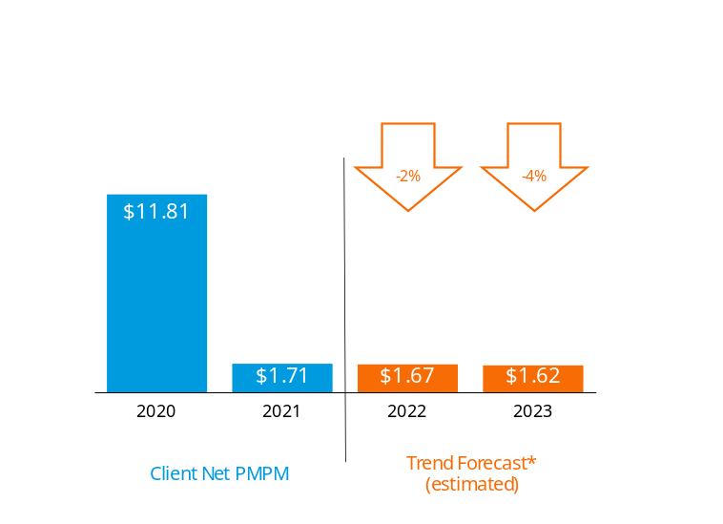
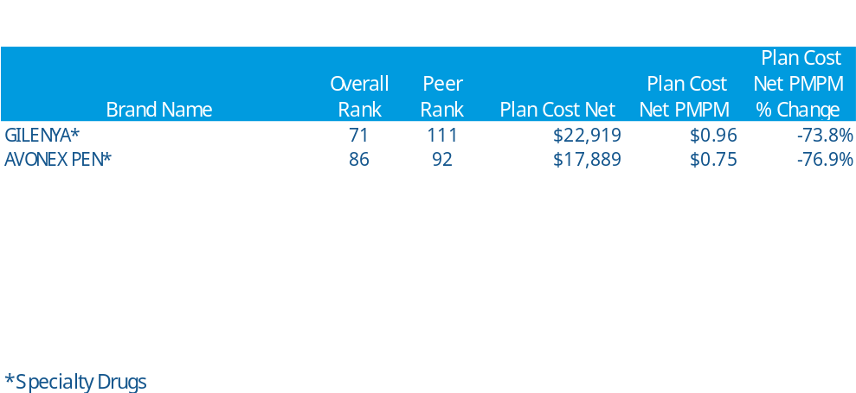
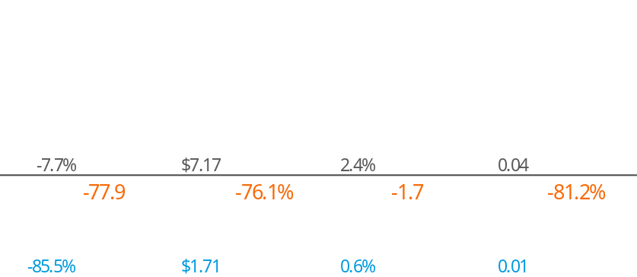
MULTIPLE SCLEROSIS
Indications driving trend
During 2020, generics and brand competition for several of the top medications to treat multiple sclerosis, including Gilenya® (fingolimod), Tecfidera® (dimethyl fumarate), and Ocrevus® (ocrelizumab), resulted in reducing unit cost trends, which is expected to spill over into 2021.
You vs. Peer
Peer = 'Commercial - EGWP' market segment
*Based on 2020 Drug Trend Report forecasted values for Commercial Plans

Slide 18
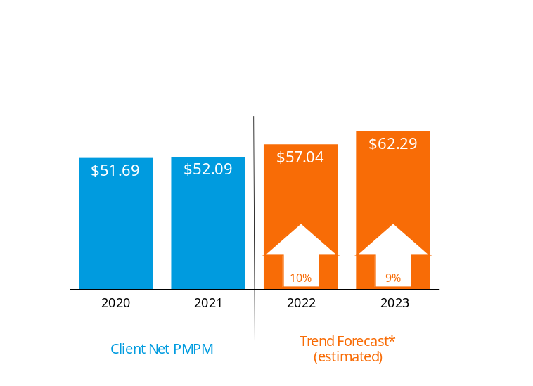
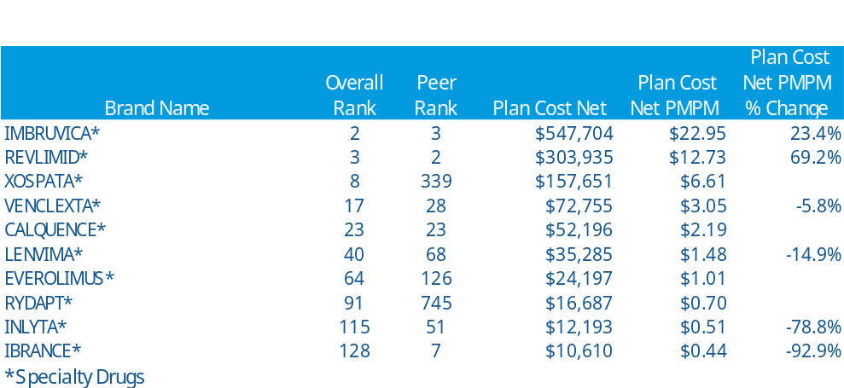
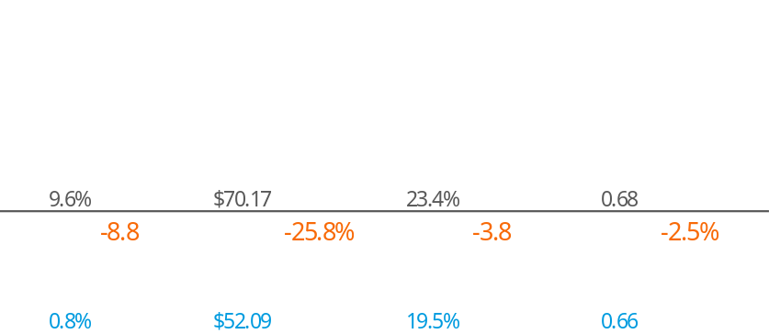
CANCER
Indications driving trend
Oncology trend is expected to increase over the next 3 years. Despite the rising costs of these expensive therapies, the generic for Sutent® (sunitinib malate) and others, could drive lower trends in 2021.
You vs. Peer
Peer = 'Commercial - EGWP' market segment
*Based on 2020 Drug Trend Report forecasted values for Commercial Plans

Slide 19
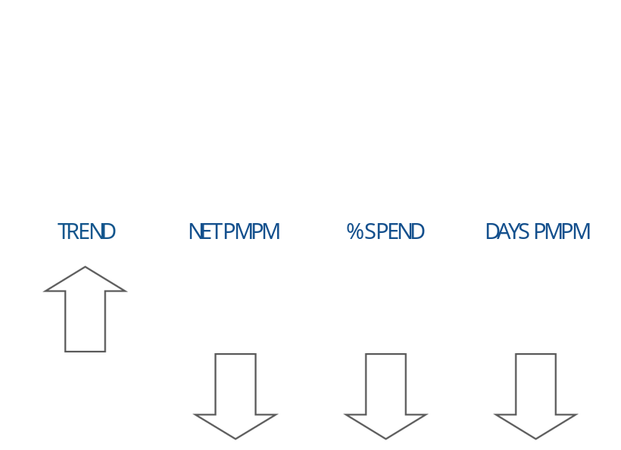
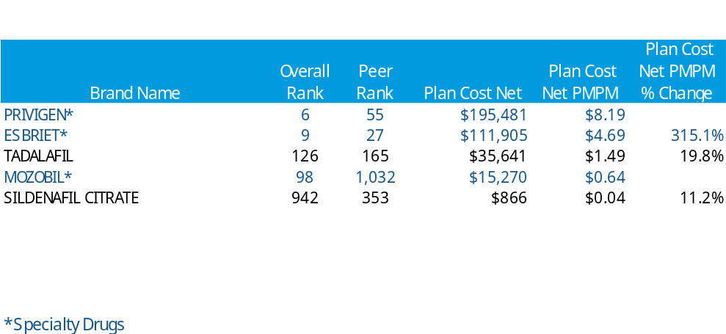
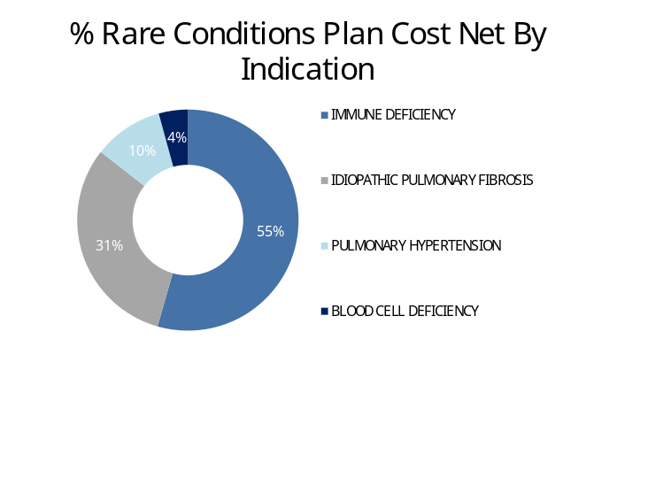

RARE CONDITIONS
Indications driving trend
Due to the advancements of therapies for Rare Conditions, patients have been able to improve their quality of life while coping with these conditions. Since these are extremely high cost medications, significant increases in the trends of these disorders in the future seem likely.
You vs. Peer
Peer = 'Commercial - EGWP' market segment

Slide 20



HEPATITIS C
Indications driving trend
It is estimated that 2.4 million people in the U.S. are living with a positive hepatitis C diagnosis and more than half of the people who become infected with HCV will develop chronic infection.¹
You vs. Peer
Peer = 'Commercial - EGWP' market segment
1. Source: Centers for Disease Control and Prevention

Slide 21
SUPPLEMENTAL

Slide 22

Plan Performance
* Rebates are estimated based on paid and expected to be paid amounts. Actual rebate payments may differ from estimates.
** Amounts are estimated. Prospective Federal Reinsurance amounts are based on the lesser of the CMS market rate and client’s most up-to-date utilization which was the most recently reconciled plan year as of the beginning of this year.
Notes:
Talking Points:
This slide is a high level look at year over year financials starting with AWP and working down to Net Cost. As you can see, rebates increase X.X% to almost $XXM. Cost to <client> after accounting for rebates was $XXX.XM. Furthermore, taking into account membership, you can see the impact rebates have on the PMPM costs and overall drug trend. PMPM cost of $XXX drops to $XXX. Drug trend is the % change in PMPM cost year to year. Before rebates trend was X.X%; after rebates it drops to X.X%.
- AWP – Average Wholesale Price (provided by Medispan):
+ AWP can increase due to manufacturer price increases and increases in utilization, and can be heavily influenced by increases in specialty spend
+ AWP may decrease if the plan experiences a drastic change/drop in utilizing members
- Network & Mail Discount Savings (includes dispensing fees):
+ This savings metric typically increases year over year with a rise in Generic Fill Rate, Home Delivery Utilization, new pricing (steeper discounts or lower dispensing fees) and higher overall Rx volume
- Gross Cost = AWP – Discounts + Dispensing Fees + Tax
+ Represents the total cost of drugs before member contributions
- Member Cost – Includes copays, coinsurance, deductibles, mandatory home delivery penalties, mandatory generic penalties, out of pocket maximums, benefit caps, etc.
+ Member cost may decrease due to GFR increasing and the lower copays typically associated with Generics
+ Typically as Home Delivery Utilization increases the Member Cost Share decreases. Most plans offer an incentive for members to move to Home Delivery in the form of a lower copay.
+ If the Gross Cost increases at a faster pace than the Member Cost, the plan experienced cost share erosion.
- Plan Cost = AWP – Discounts + Dispensing Fees + Tax – Member Cost
+ Represents what the plan pays at the point of sale. This does not account for rebates, admin fees, program fees, copay waivers (that are part of a standard copay waiver program), or federal subsidies from retiree programs (i.e., EGWP.)

Slide 23

Top Line Performance Metrics: Specialty
Notes:
Talking Points:
- Specialty spend will be defined based on the specialty drug list chosen when running the slides in Analyst
- Compare Specialty PMPM trend vs. Non-Specialty PMPM trend. Non-Specialty trend is typically lower due to the impact of patent expirations, GFR increases, etc. Specialty drugs have limited generic opportunity so higher use, inflation, and newer, more costly therapies drive Specialty trend up.
+ Specialty PMPM trend can often times drive most if not all of the overall PMPM increase, so use this slide to highlight positive performance with non-specialty when applicable, especially if driven by active plan design management and product implementation
+ The Specialty pipeline is robust so Specialty utilization is expected to continue growing in the future
+ An increase of just a few Specialty patients can cause Specialty trends to increase significantly (especially if they happen to be on very costly Specialty meds with costs >$200k per year)
- An increase may also occur if there was movement of Specialty drugs out of the medical benefit and into the pharmacy benefit. This often may be net savings for clients when comparing pharmacy specialty costs to medical specialty costs, but will only show up as a cost increase on this report.
- Compare metrics to the selected Book of Business to highlight any variances, which may aid in recommending specialty plan designs and programs.
- Drug level analysis is essential

Slide 24

Key Statistics: Specialty Detailed
Notes:
Talking Points:
- Specialty spend will be defined based on the specialty drug list chosen when running the slides in Analyst
Compare Specialty PMPM trend vs. Non-Specialty PMPM trend. Non-Specialty trend is typically lower due to the impact of patent expirations, GFR increases, etc. Specialty drugs have limited generic opportunity so higher use, inflation, and newer, more costly therapies drive Specialty trend up.
+ Specialty PMPM trend can often times drive most if not all of the overall PMPM increase, so use this slide to highlight positive performance with non-specialty when applicable, especially if driven by active plan design management and product implementation
+ The Specialty pipeline is robust so Specialty utilization is expected to continue growing in the future
+ An increase of just a few Specialty patients can cause Specialty trends to increase significantly (especially if they happen to be on very costly Specialty meds with costs >$200k per year)
- An increase may also occur if there was movement of Specialty drugs out of the medical benefit and into the pharmacy benefit. This often may be net savings for clients when comparing pharmacy specialty costs to medical specialty costs, but will only show up as a cost increase on this report.
- Compare metrics to the selected Book of Business to highlight any variances, which may aid in recommending specialty plan designs and programs.

Slide 25



Trend Components: Utilization
Intensity
Utilization
(Days/Patient)
(Days/Member)
Prevalence
(Patients/Member)
Notes:
2

Slide 26


Trend Components: Inflation
*Compounds are excluded from the Top 10 Impacted Drugs
Notes:
2Talking Points
- Inflation represents the change in AWP per quantity at a drug level and its effect on plan cost PMPM
+ Inflation is driven largely by manufacturers, and is most prevalent with specialty drugs and right before brand drugs lose patents
+ Generic drugs often have flat or very low inflation
- Inflation impact is a combination of changes in utilization and AWP/Unit. Please review both for causal impact.

Slide 27


Trend Components: Specialty Inflation
Notes:
2Talking Points:
- Inflation represents the change in AWP per quantity at a drug level and its effect on plan cost PMPM
+ Inflation is driven largely by manufacturers, and is most prevalent with specialty drugs and right before brand drugs lose patents
+ Generic drugs often have flat or very low inflation
-Inflation impact is a combination of changes in utilization and AWP/Unit. Please review both for causal impact.

Slide 28

Top 10 Indications
Peer = 'Commercial - EGWP' market segment
Notes:
Talking Points:
-If you have a high mail penetration client, please run this by adjusted Rxs to give a complete picture
-Watch for significant % changes in PMPM, which can be driven by new drugs to market, change in population, drugs off-patent, more utilizers, more generic use, clinical programs, etc.
-Highlight any significant movements in rank for any particular indication and be able to explain why (new drugs came on market, drugs went off-patent, a few patients taking a high cost drug, etc…)
-Highlight indications with low GFR and any possibilities of increasing GFR through clinical programs
-Discuss where GFR increased from last year due to new generics on market or clinical programs implemented
-Full indication listing is also available in the Excel Document
-There are additional columns hidden in the Excel file (including more detail and Formulary Compliance). However, unhiding all columns will make for a difficult slide to read on screen.
Common Obstacles
-If this report is run with the Plan Cost option, member cost share could skew results if there was a change in plan design

Slide 29

Peer Comparison by Indication

Slide 30

Top 25 Drugs
Peer = 'Commercial - EGWP' market segment
Notes:
Talking Points:
-Please run this slide as adjusted Rxs if you have a client that has significant mail penetration as it will give a more complete picture of utilization
-Highlight any significant movements in rank for any particular medication or new medications, both brand and generic.
-Be able to explain why (new drugs came on market, drugs went off-patent, a few patients taking a high cost drug, etc…)
-Highlight indications with low GFR and any possibilities of increasing GFR through clinical programs
-Discuss possible clinical programs, AUM, FWA, that might help to control utilization

Slide 31


Top Movers
Notes:
2Talking Points:
- Drugs within top 25 (by user selected top drug cost) highlighted orange in “increase” section and gray in “decrease” section
- Discuss new drugs that were not utilized in previous period, as this can often have a large impact in overall plan cost PMPM increases
- Discuss possible clinical programs that may benefit the plan sponsor and member for drugs that are increasing in cost

Slide 32

Top 10 Specialty Indications
Peer = 'Commercial - EGWP' market segment
Notes:
Talking Points:
-Definitely change to Adjusted Rxs if you have Exclusive Specialty or high mail use.
-Based on ESI standard specialty drug list (SPE 360) unless Custom Specialty List was chosen
-Watch for significant % changes in PMPM, which can be driven by new drugs to market, change in population, more utilizers, clinical programs, etc.
- Highlight any significant movements in rank for any particular indication and be able to explain why (new drugs came on market, a few patients taking a high cost drug, etc…)
- Highlight indications with significant % change in PMPM where clinical programs may be an option
-Full indication listing is also available in the Excel Document
-There are additional columns hidden in the Excel file (including more detail and Formulary Compliance). However, unhiding all columns will make for a difficult slide to read on screen.
Common Obstacles
-Rank is Overall Indication Rank – relative to all drugs
-BoB rank also represents Overall Indication Rank

Slide 33

Top 25 Specialty Drugs
Peer = 'Commercial - EGWP' market segment
Notes:
Talking Points:
-Change to adjusted Rxs if you have Exclusive Accredo or Accredo recommended Days supply to get a better idea of utilization
-Discuss changes in the market place with specialty drugs, new drugs to market, new indications, drug therapy where there was no therapy in the past.
-Discuss AUM and specialty programs that are associated with these drugs to help get the right drug to the right patient.

Slide 34

Top 10 Non-Specialty Indications
Peer = 'Commercial - EGWP' market segment
Notes:
Talking Points:
-Definitely change to Adjusted Rxs if you have Exclusive Specialty or high mail use.
-Based on ESI standard specialty drug list (SPE 360) unless Custom Specialty List was chosen
-Watch for significant % changes in PMPM, which can be driven by new drugs to market, change in population, more utilizers, clinical programs, etc.
- Highlight any significant movements in rank for any particular indication and be able to explain why (new drugs came on market, a few patients taking a high cost drug, etc…)
- Highlight indications with significant % change in PMPM where clinical programs may be an option
-Full indication listing is also available in the Excel Document
-There are additional columns hidden in the Excel file (including more detail and Formulary Compliance). However, unhiding all columns will make for a difficult slide to read on screen.
Common Obstacles
-Rank is Overall Indication Rank – relative to all drugs
-BoB rank also represents Overall Indication Rank

Slide 35

Top 25 Non-Specialty Drugs
Peer = 'Commercial - EGWP' market segment
Notes:
Talking Points:
-Change to adjusted Rxs if you have Exclusive Accredo or Accredo recommended Days supply to get a better idea of utilization
-Discuss changes in the market place with non-specialty drugs, new drugs to market, new indications, drug therapy where there was no therapy in the past.
-Discuss AUM and non-specialty programs that are associated with these drugs to help get the right drug to the right patient.

Slide 36


Upcoming Patent Expirations
GFR Savings calculation excludes Specialty drugs
and Rebate impact is not included
Notes:
Talking Points:
- This slide highlights the significant opportunity with generics and is a conservative estimate since it only includes about 30 of the major medications (based on our BOB top drugs) going off-patent in the next 4 years that show up in client’s top drugs (by ingredient cost)
- Now is the time to have a generics preferred program in place to accumulate savings as brand drugs come off patent
- Mention how many of the drugs losing patent are in the Top 10
Common Obstacles
- Important to note that these are scheduled dates (as of beginning of the quarter) for those drugs to go off-patent but those dates can change over time due to patent extensions, lawsuits, etc…

Slide 37

Generic Fill Rate Opportunity
GFR Savings calculation excludes Specialty drugs and Rebate impact is not included
Generic Fill Rate (GFR) calculated with Adjusted Rxs
Peer 1 = Express Scripts Peer 'Commercial - EGWP' market segment
Peer 2 = Express Scripts Peer 'Labor - EGWP' market segment
Notes:
2Talking Points:
- This slide compares the changes in Generic Fill Rate between the comparison periods, and calculates the savings experienced by this increase based on the difference in cost between a brand and generic
- These savings figures are high-level and based on averages
- Specialty drugs are not included in the savings calculation

Slide 38


Generic Dispensing
Slide excludes Specialty drugs
Rebate impact is not included GFR Savings calculation
Generic Fill Rate calculated with Adjusted Rxs
Notes:
Talking Points:
- Discuss the continued increase of generic fill rate over time
- Discuss any spikes or dips due to patent expirations, plan design changes, seasonality medications, etc.
- Compare generic fill rates with book of business or peer data to show potential opportunities that can be discussed. Opportunities can include copay changes that incentivize generics, step therapy rules, etc.
- Highlight the immense opportunity to save money by focusing on the bar graphs, which show the amount the plan can save on average by increasing GFR in one percentage point increments
Calculations*:
- Generic Savings* = (avg cost of brand Rx - avg cost of generic Rx) x (GFR in curr period – GFR in prev period) x Number of total current Rxs
- Savings as a % of plan cost = Generic savings* / (Curr Total Plan cost + Generic Savings*)
- Calculations for retail and home delivery are performed separately to ensure day supply is adjusted for appropriately
- Specialty drugs are excluded in the calculation of average brand drug prices to keep from overinflating the average price of a brand and thus overinflating savings, given most specialty drugs do not have a generic alternative

Slide 39


Value of Rebates
* Rebates are estimated based on paid and expected to be paid amounts. Actual rebate payments may differ from estimates.
Notes:
This slide can be used to supplement a conversation about rebates. In the bullet points and the tables, it has all the major numbers impacted by rebates.

